Slide 1
Flavor Finder
Group 3
Sankalp Kulkarni
Vishal Anand Gupta
Kapish Krishna
Rathil Madihalli
Shrishty Mishra

Slide 2
Table of contents
01
02
03
04
05
Problem Statement
Data
Sources
Analysis
Methodology
Results
Insights & Recommendations

Slide 3



Problem Statement (1/2)
Austin
Chicago
I love this restaurant so much. I wonder if I can find something similar in Chicago where I am travelling next week

Slide 4
Problem Statement (2/2)
The idea of this project is to recommend users restaurants similar to their liking when they travel to a new city.
We have tried to build recommendations in such a manner that we recommend not just most similar restaurants overall but also those restaurants which are unique to Chicago but still similar to user’s taste and preferences.

Slide 5

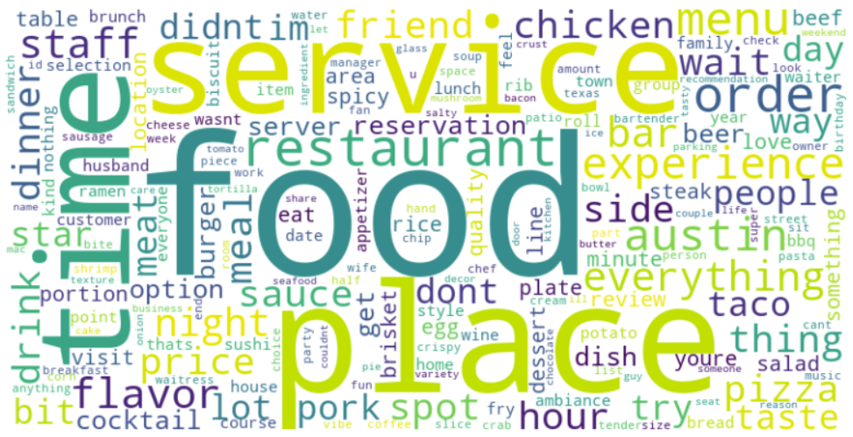
Data Source
Specifications:
Scraped data from ‘Yelp’ website for Austin and Chicago cities
Total 240 restaurants’ reviews consolidated for each of the city

Slide 6



Analysis Methodology (1/3)
Combine And Clean
Combine all reviews at restaurant level
Remove stop-words, punctuations and lemmatize
Restaurant 1 | “ We enjoyed our four appetizers followed by the salads “
Restaurant 2 | “I couldn't resist ordering the appetizers and a cocktail with Grey Goose Vodka. But they both were underwhelming.“
1
Filter Nouns
We realized, looking at the top frequency words, that the differentiating attributes, that the restaurants are generally described in terms of, are nouns.
Hence, we decided to filter nouns for further analysis
Restaurant 1 | “ We enjoyed our four appetizers followed by the salads “
Restaurant 2 | “I couldn't resist ordering the pizza and a cocktail with Grey Goose Vodka. But they both were underwhelming“
2
Highest Lift Attributes
For each restaurant we got a list of top 50 attributes in terms of lift scores
This ensures these words are both high frequency as well as differentiating for each restaurant
 | Appetizers | Salads
R1 | 3.2 | 4.5
 | Cocktail | Pizza
R2 | 4.4 | 3.6
3
Continued in next slide……

Slide 7



Analysis Methodology (2/3)
Union All Attributes
We union the restaurant level top attributes to create a city level attributes
4
Appetizers | Salads | Cocktail | Pizza
Calculate Lift
Calculate lift for each attribute vis-à-vis each restaurant
 | Appetizers | Salads | Cocktail | Pizza
R1 | 3.2 | 4.5 | 1.1 | 1.4
R2 | 1.5 | 1.2 | 4.4 | 3.6
5
Calculate Sentiment
Calculate sentiment for each attribute vis-à-vis each restaurant
 | Appetizers | Salads | Cocktail | Pizza
R1 | 0.7 | 0.8 | 0.3 | 0.2
R2 | 0.3 | 0.4 | 0.1 | 0.5
6
Continued in next slide……
Notes:
After getting the top 50 attributes of each restaurant, we took a unioin of all those attributes of all 240 restaurants in Austin. We got more than 1700 attributes.
Then, we calculated the lifts of all 1700 attributes for each restaurant. Later, we computed the average sentiment of each attribute for all restaurants using Vader.

Slide 8



Analysis Methodology (3/3)
Lift X Sentiment
Multiply lift values with sentiment scores to get the final vectors for each restaurant
 | Appetizers | Salads | Cocktail | Pizza
R1 | 2.4 | 3.2 | 0.3 | 0.2
R2 | 0.3 | 0.2 | 1.2 | 1.5
7
Repeat for 2nd City
Repeat the process for the 2nd city except we will have the same dimensions of vectors as discovered in the 1st city
 | Appetizers | Salads | Cocktail | Pizza
R1 | 3.2 | 4.5 | 1.1 | 1.4
R2 | 1.5 | 1.2 | 4.4 | 3.6
8
Find Similar Restaurants
Calculate cosine similarity between the restaurant of choice from city 1 vs all restaurants of city 2.
Get the top 3 restaurants in terms of highest cosine similarity
Ra
9
R1
Rb
Rc
Notes:
Then, we multiplied the lift value and sentiment of each attribute to get overall score. We used that score to represent each restaurant as a vector – 1700 dimensional vector. Now, all 240 restaurants are represented by 1700 dimensional vectors. We repeated the process for Chicago. However, we used same 1700 odd attributes of Austin to compute the vectors of Chicago restaurants. Once we got the vectors, we just used cosine simtake dot product of any two vectors to caculate the simila

Slide 9
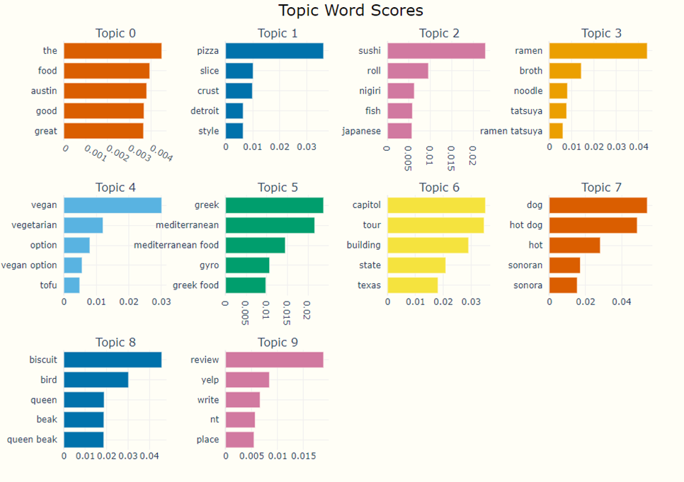
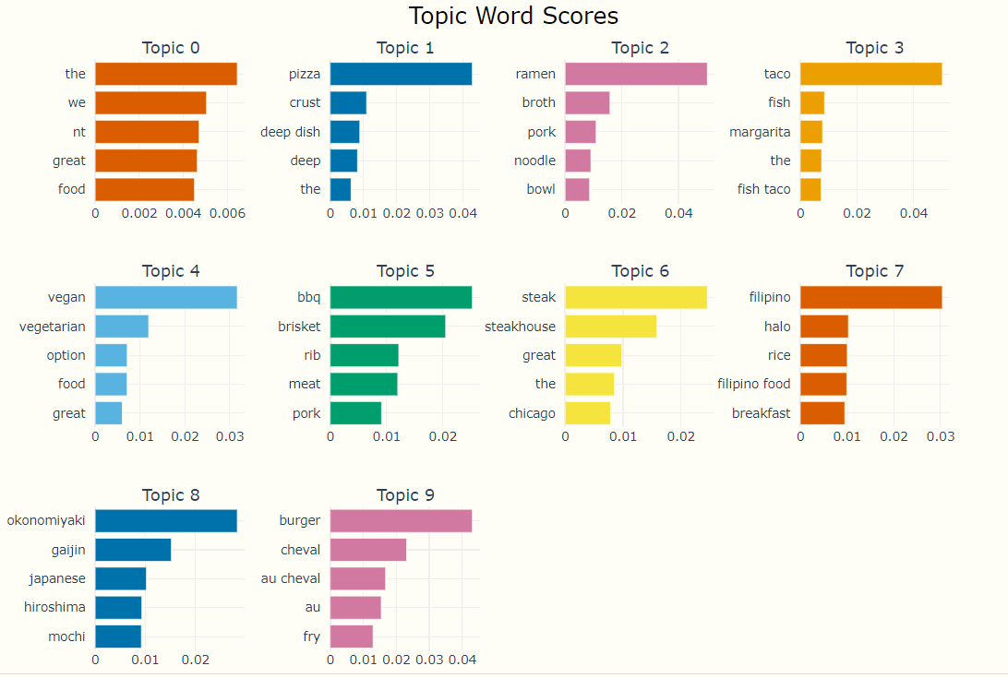
Topic Modelling
Austin
Chicago

Slide 10
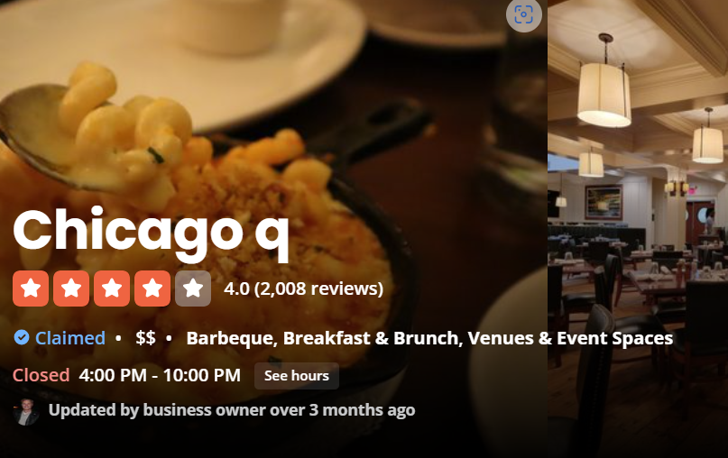
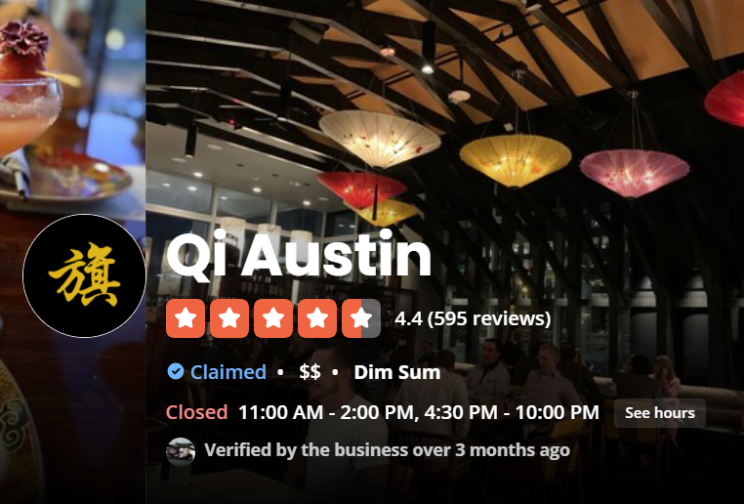
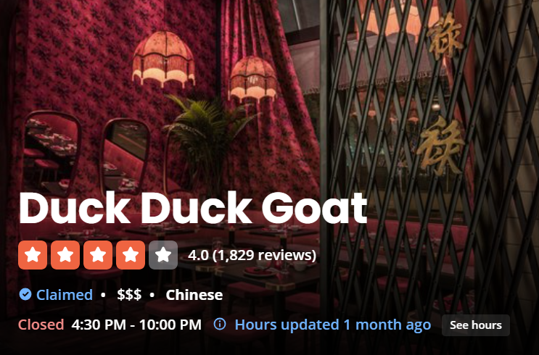

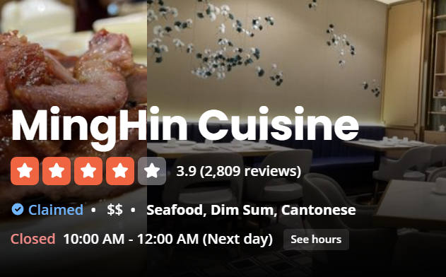
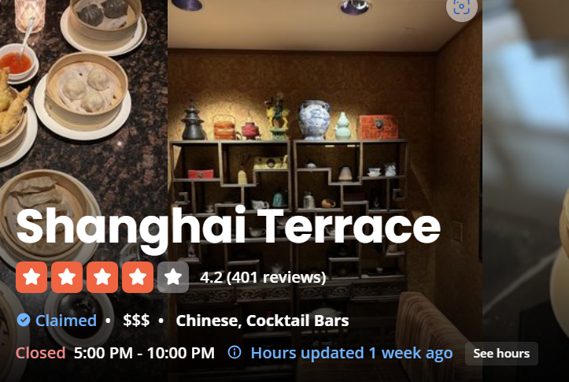
Results
Flavor Finder

Slide 11
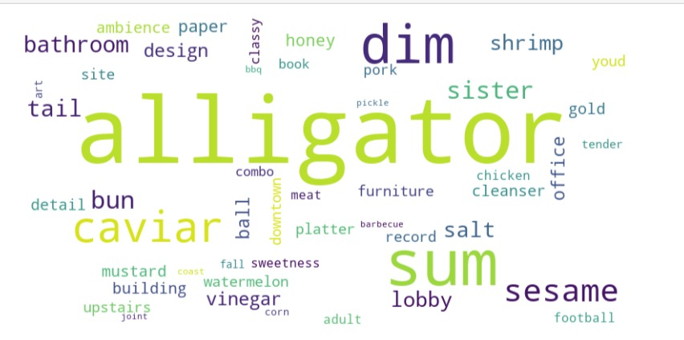
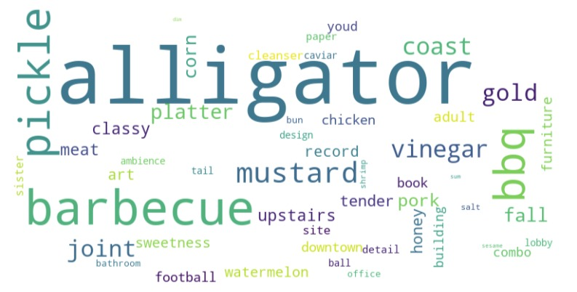
Insights
Why is a Barbecue, Breakfast and Brunch restaurant showing up as most similar to Qi Austin?
Qi Austin
Chicago q

Slide 12












Business Impact
Customer
Website
Restaurants
Intuitive search
Improved relevance
Higher Customer Satisfaction
More and better traffic
Longer dwell time
(User Engagement)
Monetization Opportunities
(e.g. Higher CPC for Advertisers)
Precision Exposure
Tailored Fulfillment
Better ratings/reviews

Slide 13
Appendix

Slide 14
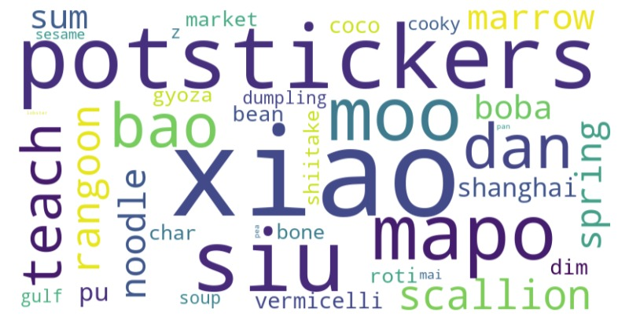
Duck Duck Goat

